Slide 1
Understanding the relationship between numerous biological metrics to the occurrence of heart failure
Presented by Heartful
AI Course
Notes:
Note:

Slide 2
Biometrics and Heart Failure
Pitch:
1.1. Introduction
1.2. Dataset
1.3. Exploratory Data Analysis
1.4. Models
1.5. Conclusion
Notes:
Note:

Slide 3

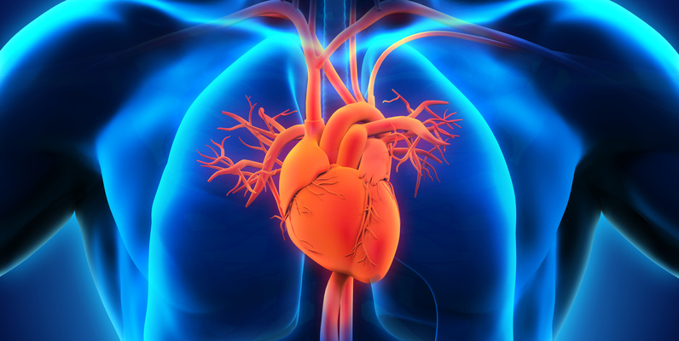
Pitch. 1.1. Introduction
Introduction
The number one cause of death globally is cardiovascular diseases (CVD’s). It accounts for 31% of deaths in the world, and it is in the best interest of the medical world to have access to data that shows significant or even sufficient evidence towards the potential occurrences of heart failures.
Spotting early signs of cardiovascular disease or those who are at risk of it with a machine learning model may prove to be a valuable project to take on that could save many lives, as well as understanding the priority of patients at risk.
Our goal -> predicting whether one has a heart disease based on measured biological data

Slide 4
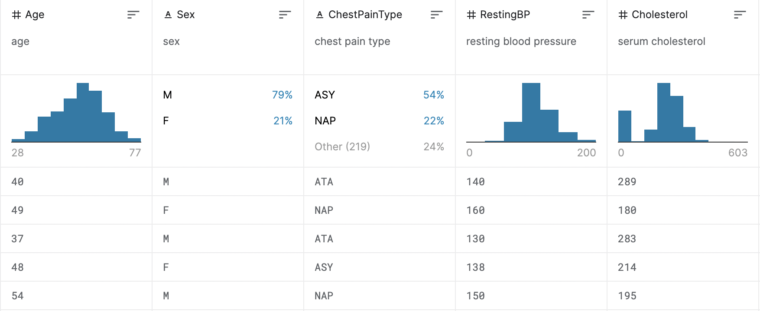
Pitch. 1.2. Data
Dataset
Data Set
Input: categorical and continuous numeric
output: 0 and 1 for heart failure
The data contains 918 observations in 12 variables.
fedesoriano. (September 2021). Heart Failure Prediction Dataset. Retrieved [April 22, 2022] from https://www.kaggle.com/fedesoriano/heart-failure-prediction.
Notes:
Age - integer numeric values
Sex - M/F categorical encoded
ChestPainType - TA: Typical Angina, ATA: Atypical Angina, NAP: Non-Anginal Pain, ASY: Asymptomatic
RestingBP - resting blood pressure
Cholesterol - cholesterol levels
FastingBS - fasting blood sugar
RestingECG - resting electrocardiogram results - categorical
MaxHR - max heart rate
ExerciseAngina - whether they have exercised induced angina
Oldpeak - exercise relative to rest in measurement of oscillations in vein activity
ST_Slope - slope of the change
HeartDisease - whether someone has heart disease

Slide 5
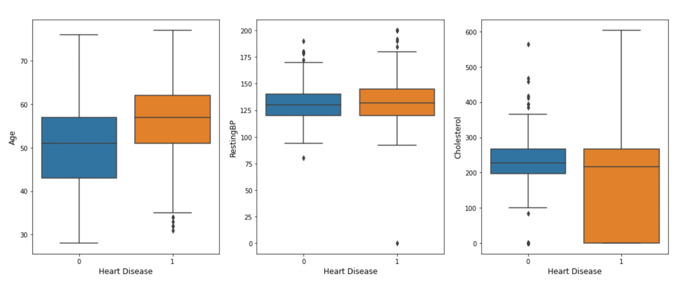
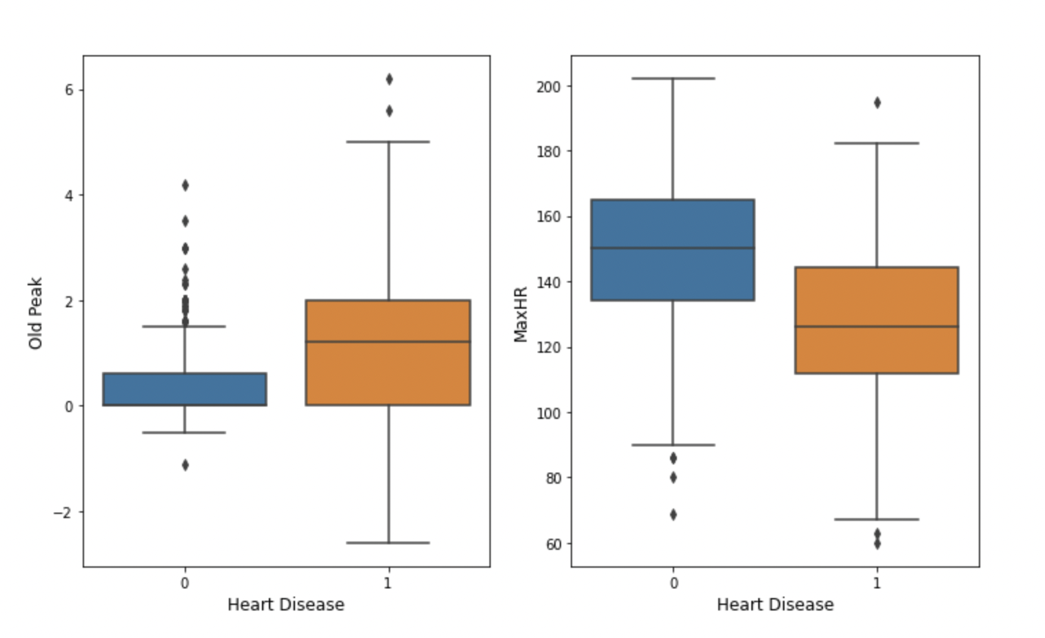
Pitch. 1.3. Exploratory Data Analysis and Preprocessing
Exploratory Data Analysis and Preprocessing
Split the columns into input and output for the model
Normalize continuous numeric biometric values to be between 0 and 1
Encode string value categorization for sex, chest pain type, resting ECG, exercise Angina, ST slope to be numerical integer representations
Split 918 into train and test data with k-fold cross validation
The output will be 2 categories of 0—1 whether this person had a heart failure or not
Notes:
In our EDA, we evaluated numerous aspects of our dataset in order to gain an insight on how to analyze and effectively discover insights.In a box plot analysis, all of the different variables in consideration have significant overlaps with the presence of heart disease though there are only two possible values in the heart disease column. The correlations between each individual variable and the output are not strong < 0.3. We use pair plots to understand the best set of features for predicting the output as well as the clusters among the variables.

Slide 6
Pitch. 1.4. Models
Models
In predicting the occurrence of heart failures, we compared five models. (Chart and graph)
Models | Accuracies
Logistic Regression | 0.880
Random Forest | 0.891
K-nearest neighbor | 0.884
XGBoost | 0.884
Support Vector Machine | 0.891
Notes:
Random forest model combines the outputs of multiple decision trees to reach a result that avoids overfitting and bias. It provides flexibility and makes it easy to determine feature importance. The support vector machine serves to find a hyperplane in an N-dimensional space that classifies data points. It is effective in high dimension cases, and is memory efficient and uses different kernel functions.

Slide 7
Pitch. 1.5. Conclusion
Conclusion
Through many epochs of trial and error, our team has concluded that the SVM and random forest models were able to best capture this dataset at an accuracy of 89.1%. Using this model, wrapped in a user-friendly interactive Python script, medical professionals could find out how much a certain patient is at risk of heart failure in comparison to previous patients in the matters of second without wasting precious time and resources on further investigation in order to ensure an efficient and optimized workflow for getting each patient the help they need.

